Slide 1
HOUSING: PRICE PREDICTION
By
VANISREE P.G

Slide 2
INTRODUCTION
Investment is a business activity that most people are interested in this globalization era. There are several objects that are often used for investment, for example, gold, stocks and property. In particular, property investment has increased significantly since 2011, both on demand and property selling . One of the increasing of property demand is because of high population in Indonesia. Indonesian Central Bureau of Statistics states that in East Java 50% of the population of East Java classified as a young population who have age approximately at 30 years old . The result of this census indicates that the younger generation will need a house or buy a house in the future.

Slide 3
Based on preliminary research conducted, there are two standards of house price which are valid in buying and selling transaction of a house that is house price based on the developer (market selling price) and price based on Value of Selling Tax Object (NJOP). According to Lim, et al the fundamental problem for a developer is to determine the selling price of a house .
In determining the price of home, the developer must calculate carefully and determine the appropriate method because property prices always increase continuously and almost never fall in the long term or short

Slide 4
PROBLEM STATEMENT
Houses are one of the necessary need of each and every person around the globe and therefore housing and real estate market is one of the markets which is one of the major contributors in the world’s economy. It is a very large market and there are various companies working in the domain. Data science comes as a very important tool to solve problems in the domain to help the companies increase their overall revenue, profits, improving their marketing strategies and focusing on changing trends in house sales and purchases. Predictive modelling, Market mix modelling, recommendation systems are some of the machine learning techniques used for achieving the business goals for housing companies. Our problem is related to one such housing company.

Slide 5
A US-based housing company named Surprise Housing has decided to enter the Australian market. The company uses data analytics to purchase houses at a price below their actual values and flip them at a higher price. For the same purpose, the company has collected a data set from the sale of houses in Australia. The data is provided in the CSV file below.
The company is looking at prospective properties to buy houses to enter the market. You are required to build a model using Machine Learning in order to predict the actual value of the prospective properties and decide whether to invest in them or not. For this company wants to know:
Which variables are important to predict the price of variable?
How do these variables describe the price of the house?

Slide 6
Data Sources
Data files are get from Flip Robo . The data is provided in the CSV file they are test.csv, train.csv file. A detailed description of data also give to know about each attribute in dataset in a ‘txt ‘ file format.
They are totally 1168 rows and 81 columns in a train.csv file. 292 rows and 80 columns in test.csv file . Our target is to find the insights of the data and to do thorough data analysis.
We have to import libraries necessary for data analysis. After we have to uploading the data using the excel file provided in two different Data Frames
df1-train.csv file
df2- test.csv file

Slide 7
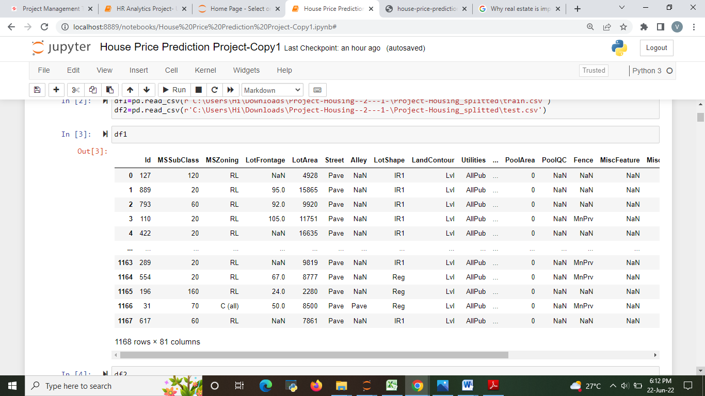

Slide 8
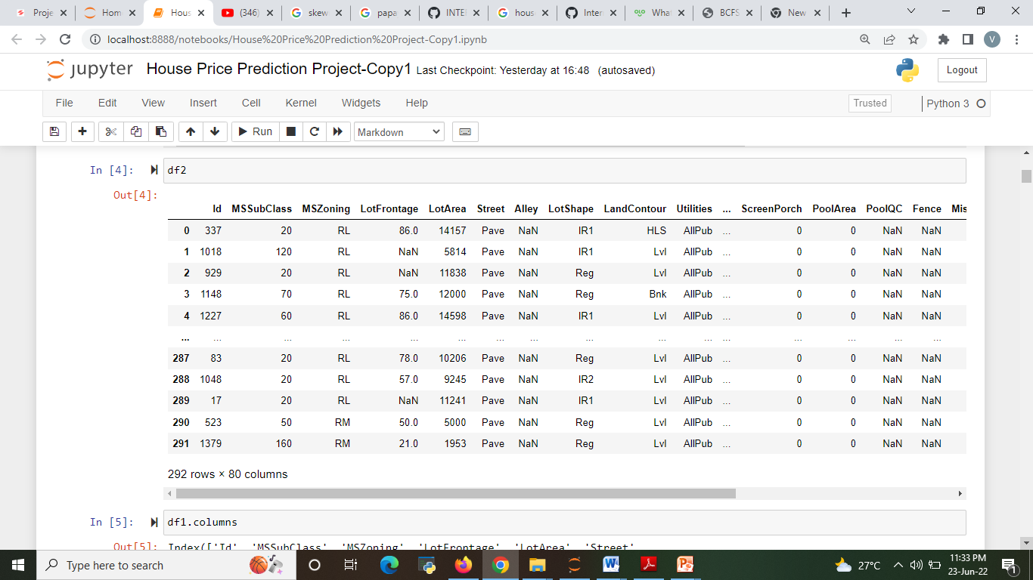

Slide 9
Conceptual Background of the Domain Problem
In real estate the value of property usually increases with time as seen in many countries. One of the causes for this is due to rising population.
The value of property also depends on the proximity of the property, its size its neighbourhood and audience for which the property is subjected to be sold. For example if audience is mainly concerned of commercial purpose. Then the property which is located in densely populated area will be sold very fast and at high prices compared to the one located at remote place. Similarly if audience is concerned only on living place then property with less dense area having large area with all services will be sold at higher prices.
The company is looking at prospective properties to buy houses to enter the market. We are required to build a model using Machine Learning in order to predict the actual value of the prospective properties and decide whether to invest in them or not.

Slide 10
Motivation for the Problem Undertaken
To understand real world problems where Machine Learning and Data Analysis can be applied to help organizations in various domains to make better decisions with the help of which they can gain profit or can be escaped from any loss which otherwise could be possible without the study of data .One of such domain is Real Estate.
Houses are one of the necessary need of each and every person around the globe and therefore housing and real estate market is one of the markets which is one of the major contributors in the world’s economy. It is a very large market and there are various companies working in the domain. Data science comes as a very important tool to solve problems in the domain to help the companies increase their overall revenue, profits, improving their marketing strategies and focusing on changing trends in house sales and purchases. Predictive modelling, Market mix modelling, recommendation systems are some of the machine learning techniques used for achieving the business goals for housing companies. Our problem is related to one such housing company.

Slide 11
HARDWARE AND SOFTWARE REQUIREMENTS AND TOOLS USED
Hardware used for doing the project is a ‘Laptop’ with high end specification and stable internet connection .while coming to the software part I had used ‘python jupyter notebook’ for do my python program and data analysis.
Excel file and Microsoft excel are required for the data handling. In jupyter notebook I had imported lot of python libraries are carried to this project and I have mentioned below detailed.
1.Pandas-a library which is used to read the data ,visualization and analysis of data.
2.Numpy-used for working with array and various mathematical operations in python.
3.Seaborn- visualization for plotting different type of plot.
4.Matplotlib- It provides an object-oriented API for embedding plots into applications .

Slide 12
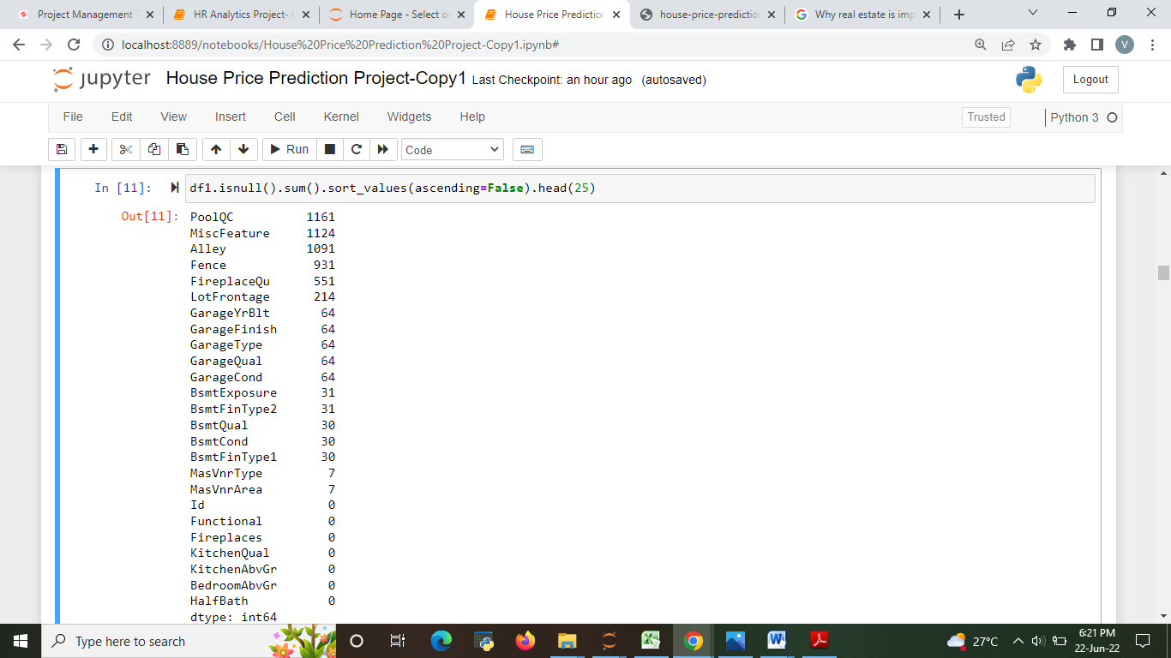
DATA ANALYSIS
The raw data is taken and performed various steps to reduce skewness, outlier, class imbalance and scaling.
Checking missing value from the data set.
There were null value was present in the dataset but there are some outliers which also get too removed.

Slide 13
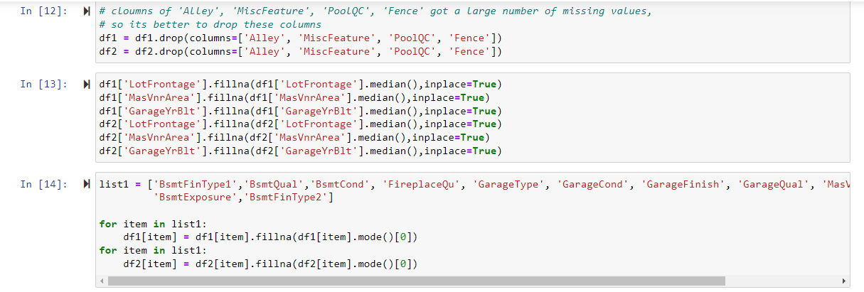
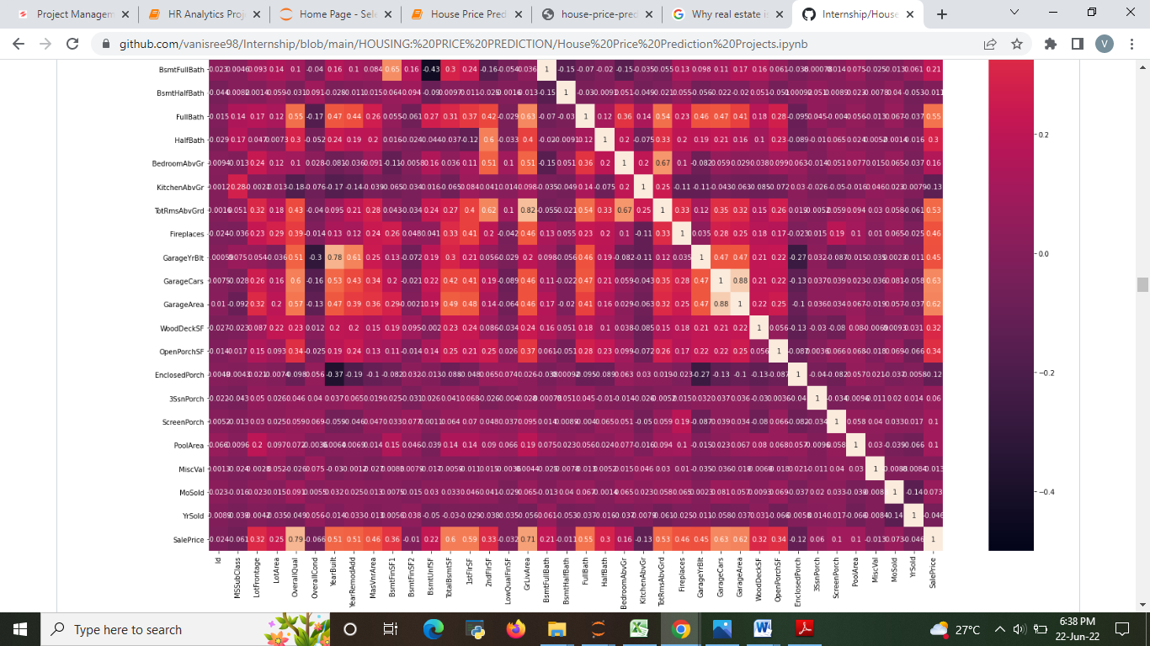
We drop large number of missing value columns. some other columns have null values these are Filled by mean ,median and mode.
CORRELATION

Slide 14
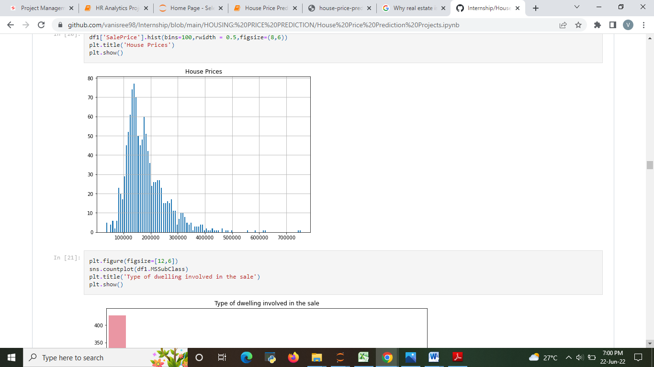
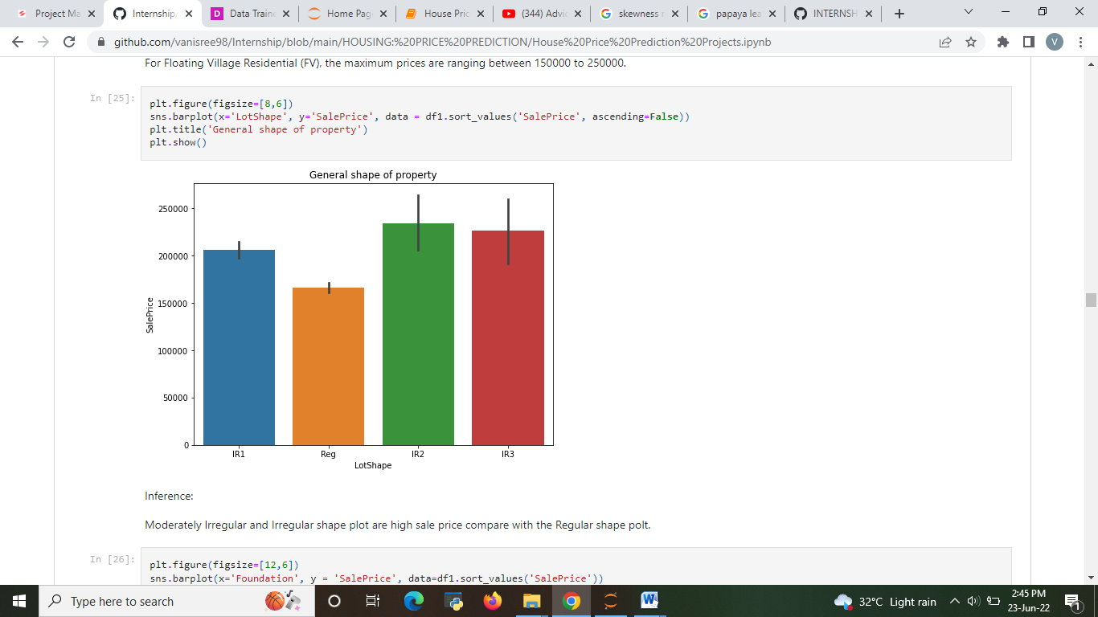
Data Visualizations
Graph based on sale price of the house.100000 to 400000 are range of sale price of house.

Slide 15
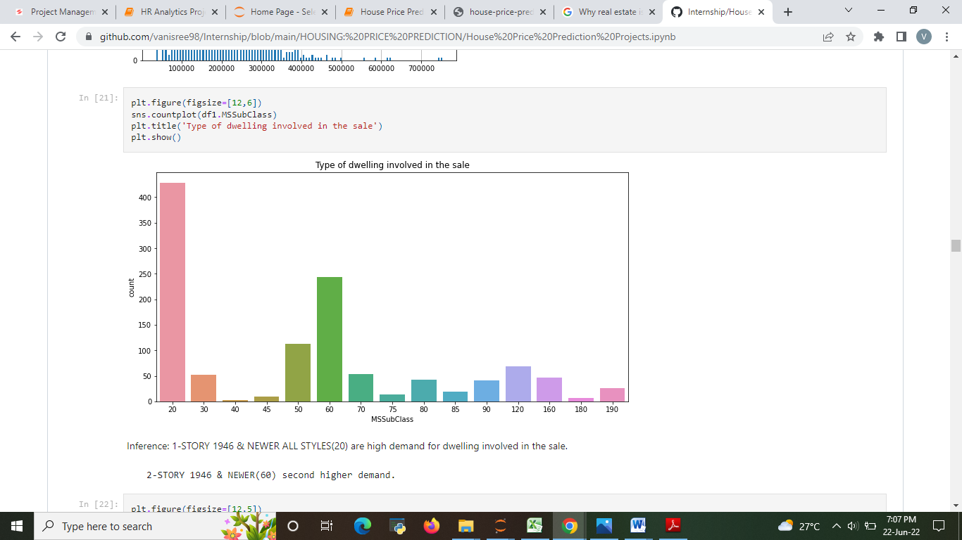
Type of dwelling involved in the sale
1-STORY 1946 & NEWER ALL STYLES(20) are high demand for dwelling involved in the sale.
2-STORY 1946 & NEWER(60) second higher demand.
the property with the road access of Pave is in more demand and so its price is also high

Slide 16
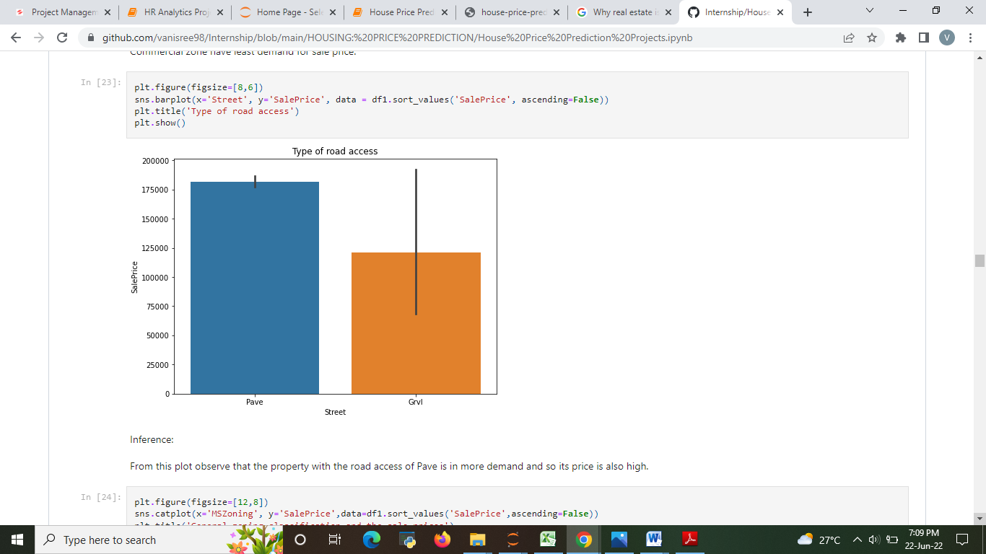
Road access
the property with the road access of Pave is in more demand and so its price is also high

Slide 17
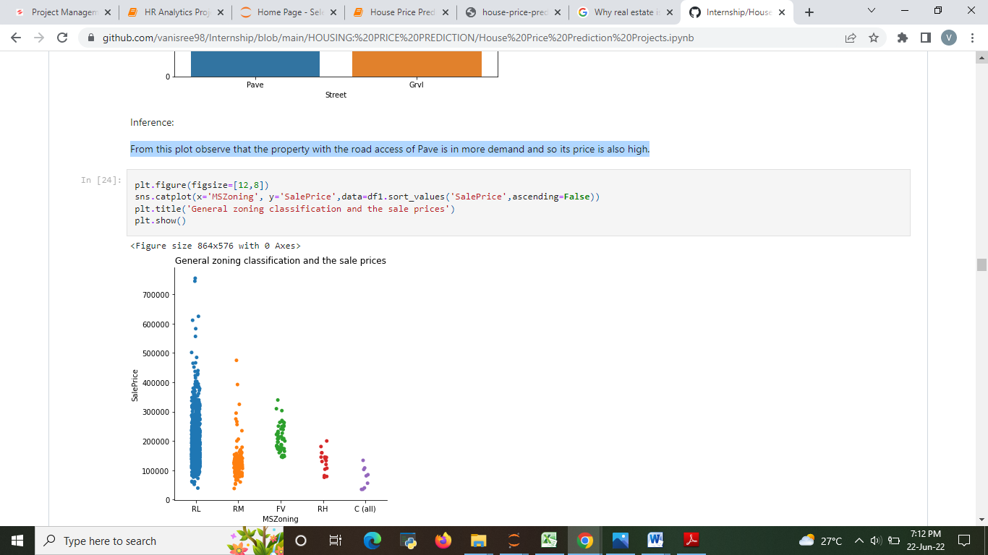
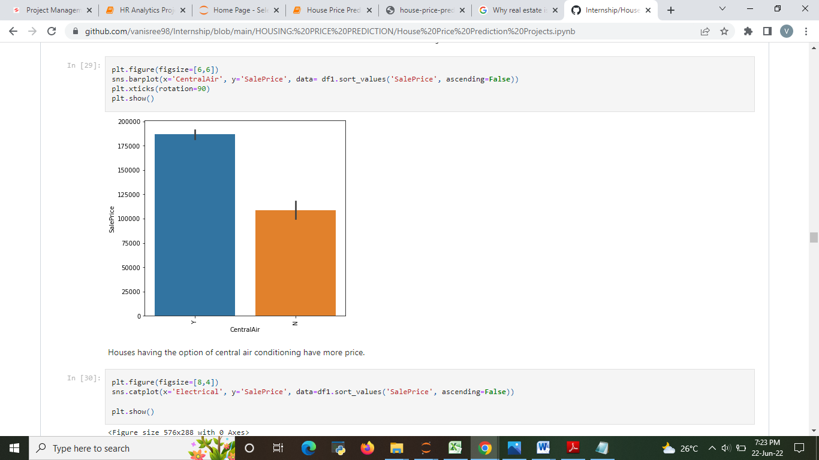
Identifies the general zoning classification of the sale.
Central air conditioning

Slide 18
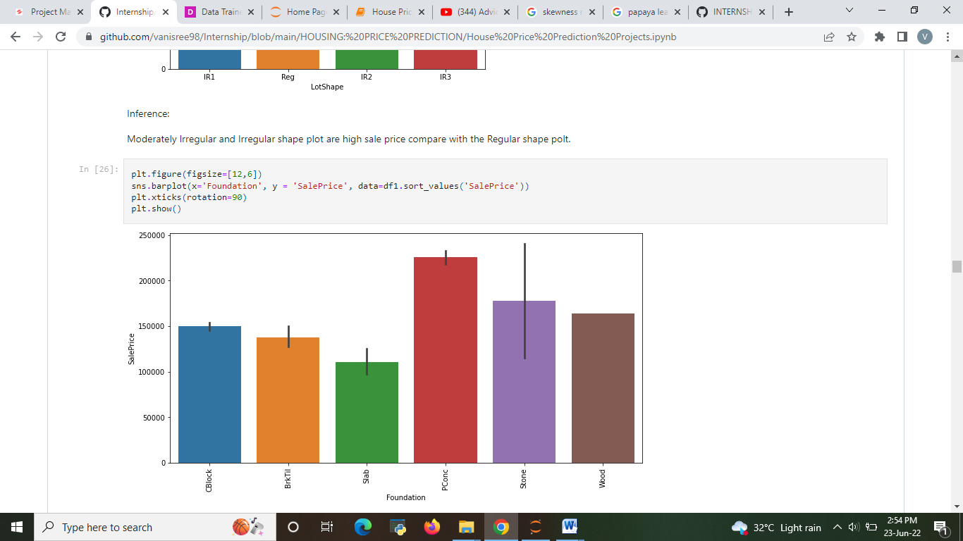
Type of foundation
slab foundation have least sale price.
Poured Contrete foundation have high sale price

Slide 19
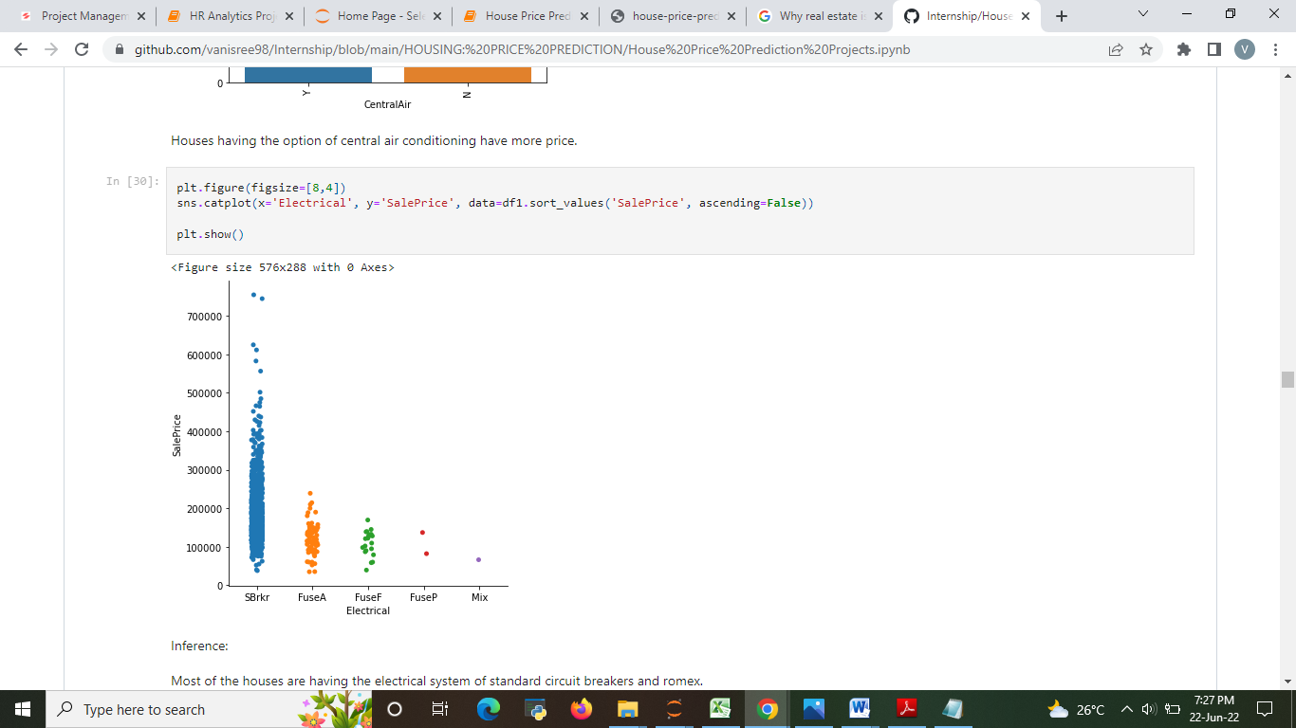
Electrical system
Most of the houses are having the electrical system of standard circuit breakers and romex.
Least of the houses are having the Fuse Box and mostly knob & tube wiring (poor) and mixed.

Slide 20
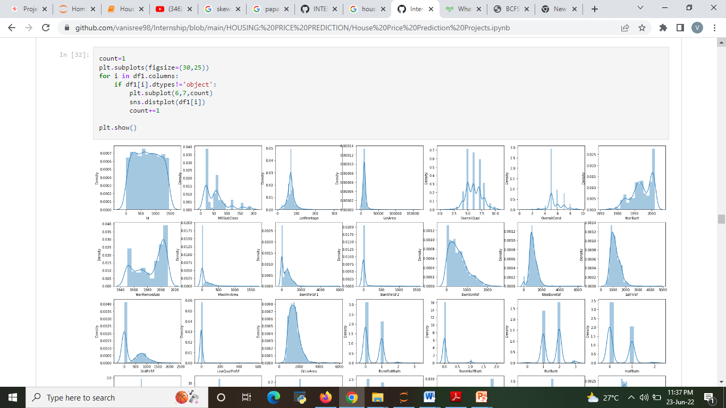
Checking skewness

Slide 21
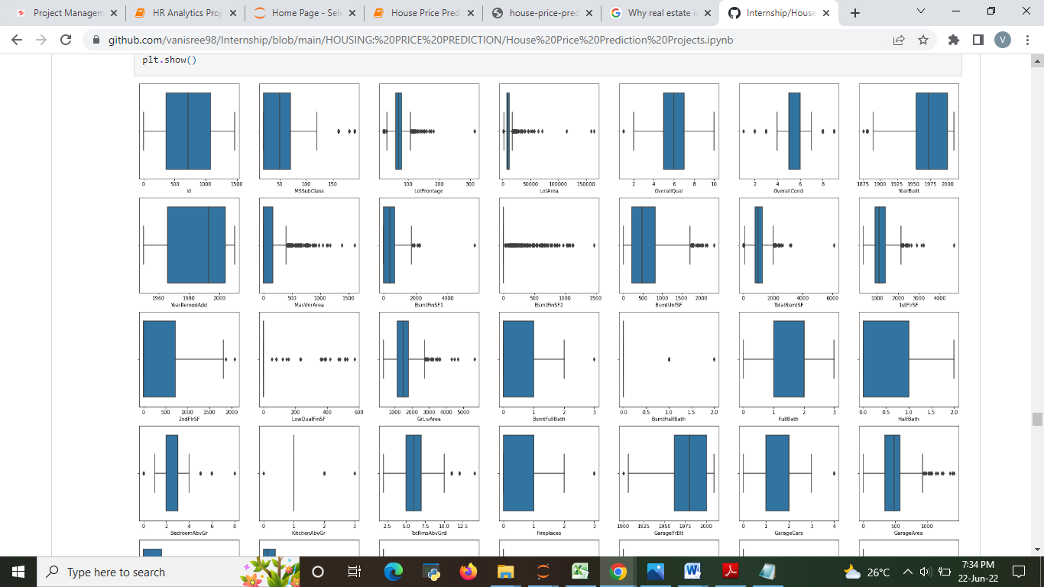
Checking the outliers
If we perform outliers removal the data loss will be high so not performing outliers removal Technique.

Slide 22
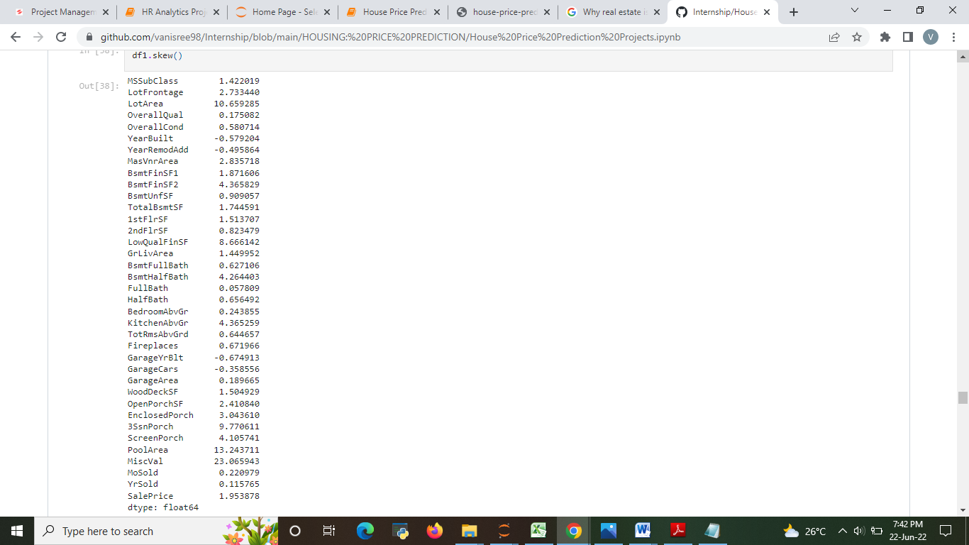
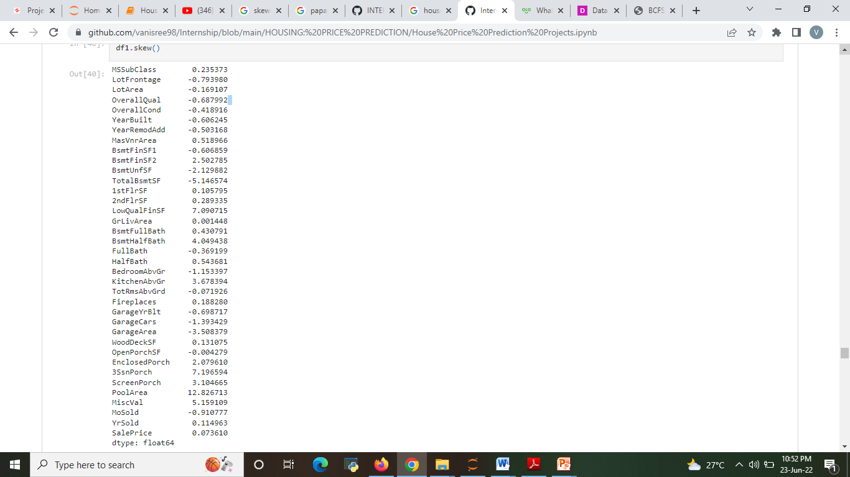
Reduce the skewness
Skewness present
Skewness not presented

Slide 23
MODELS USED
Classification Model with following algorithms
Linear Regression
Random forest Regression
Decision Tree Regression
Evaluation metrics
Mean Absolute error
Mean square error
Root mean squared error
Variance
R2 score

Slide 24
Testing of Identified Approaches (Algorithms)
Listing down all the algorithms used for the training and testing.
LR=LinearRegression()
DT=DecisionTreeRegressor()
RF=RandomForestRegressor()
Svm=SVM()
GBR=GradientBoostingRegressor()

Slide 25
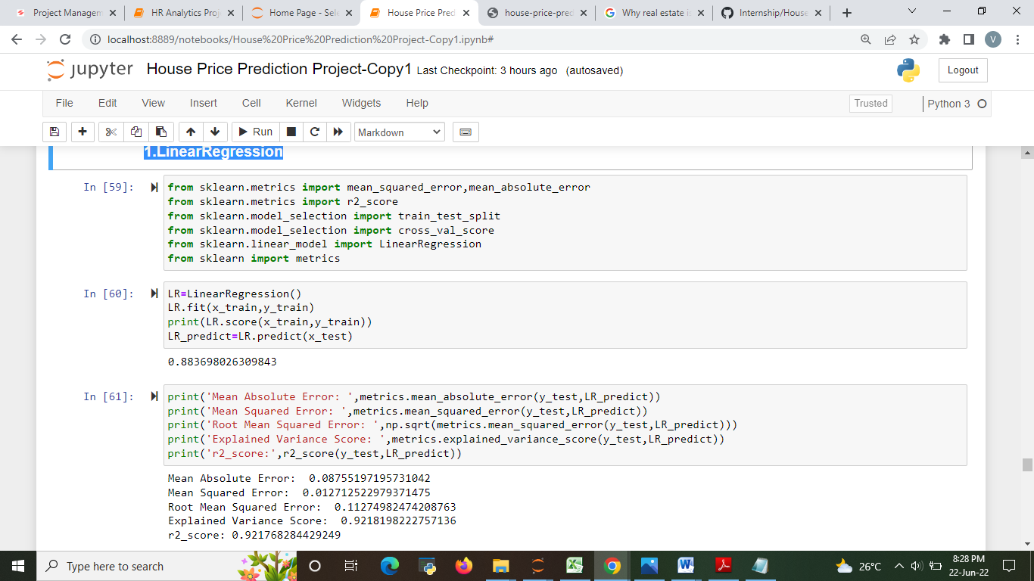
Evaluate selected models
Describe all the algorithms used along with the snapshot of their code and what were the results observed over different evaluation metrics.
1.Linear Regressor

Slide 26
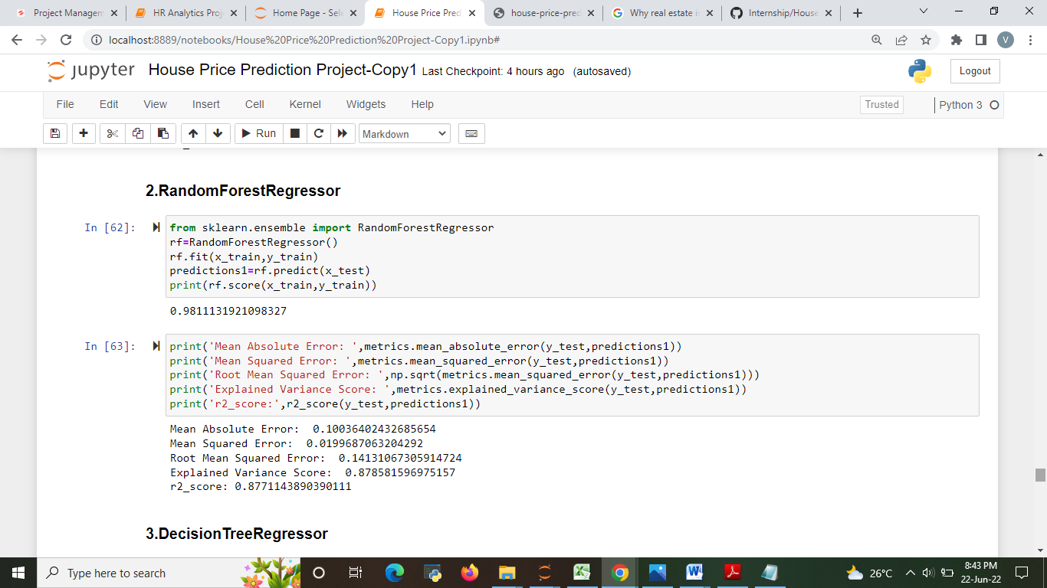
2.Random Forest Regressor

Slide 27
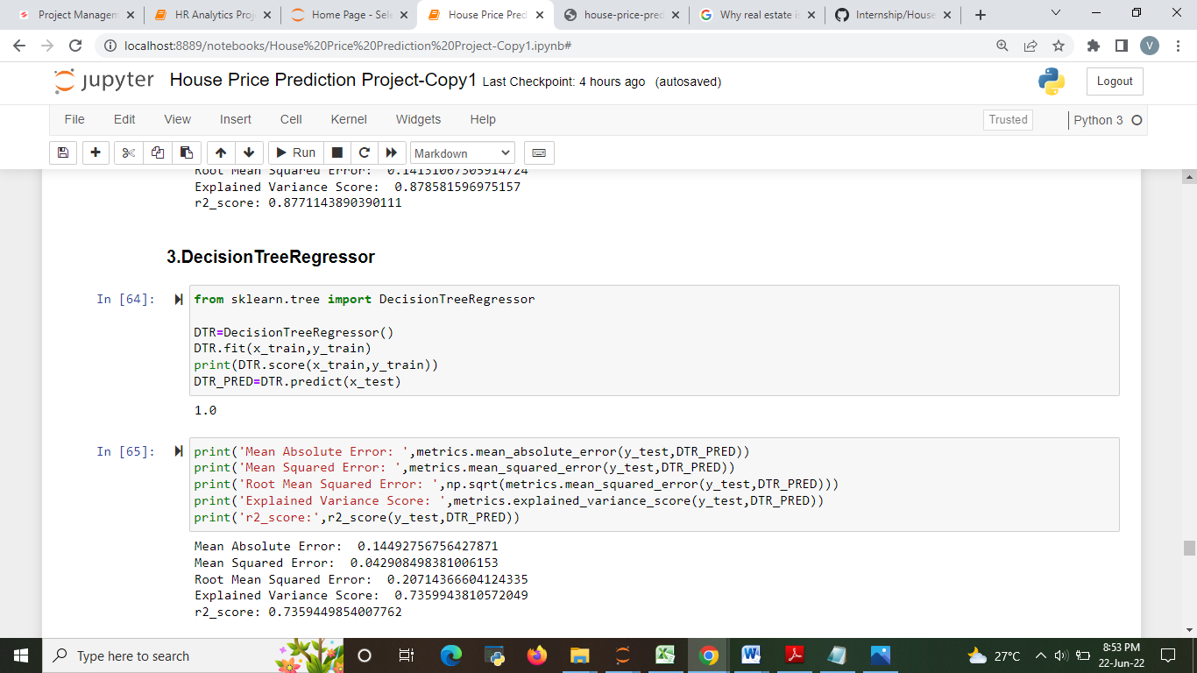
3. Decision Tree

Slide 28
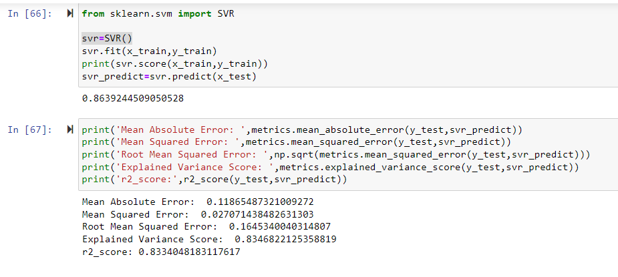
4.SVR

Slide 29
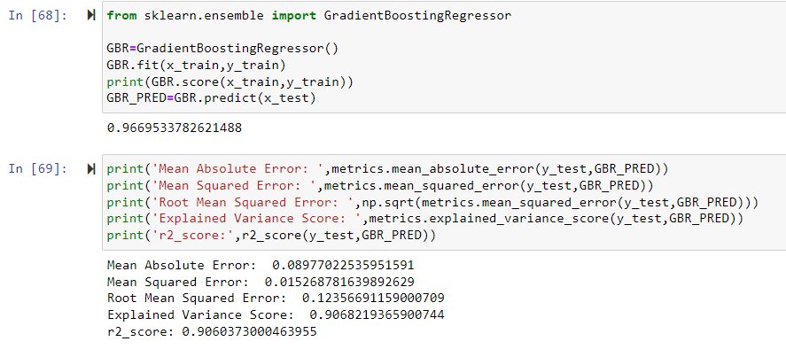
5.Gradient Boosting Regressor

Slide 30
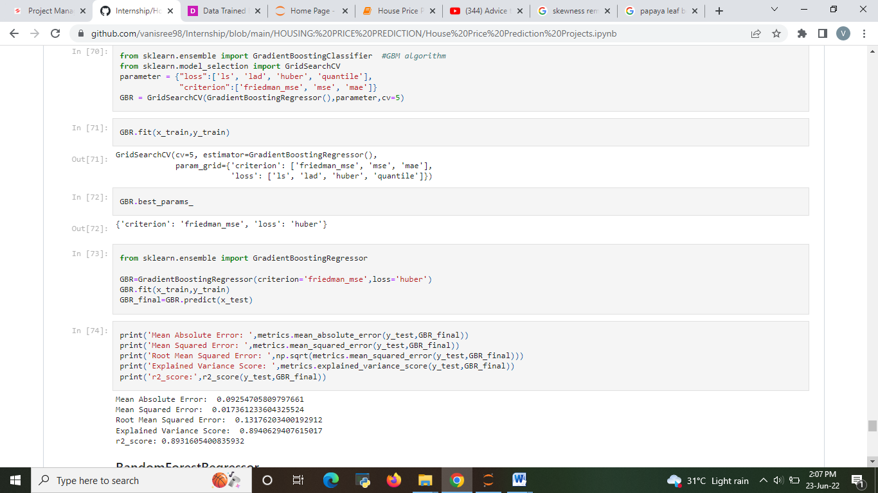
Hyper parameter tuning
GradientBoostingRegressor

Slide 31
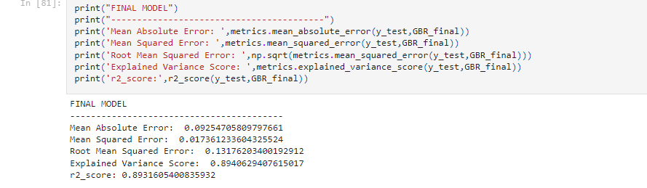
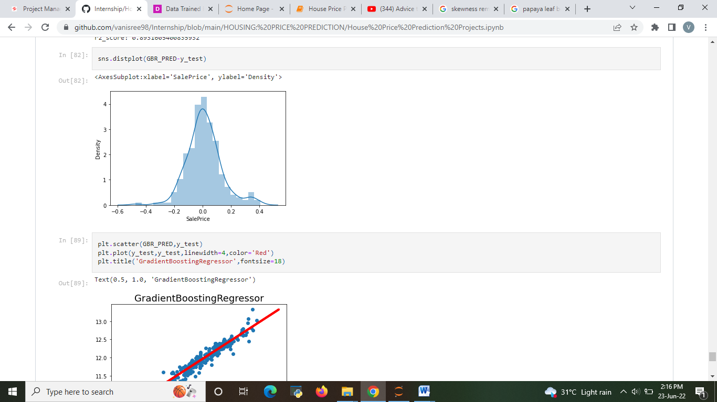
The best model after hyper parameter tuning is GradientBoostingRegressor has 89% of accuracy.
FINAL MODEL

Slide 32
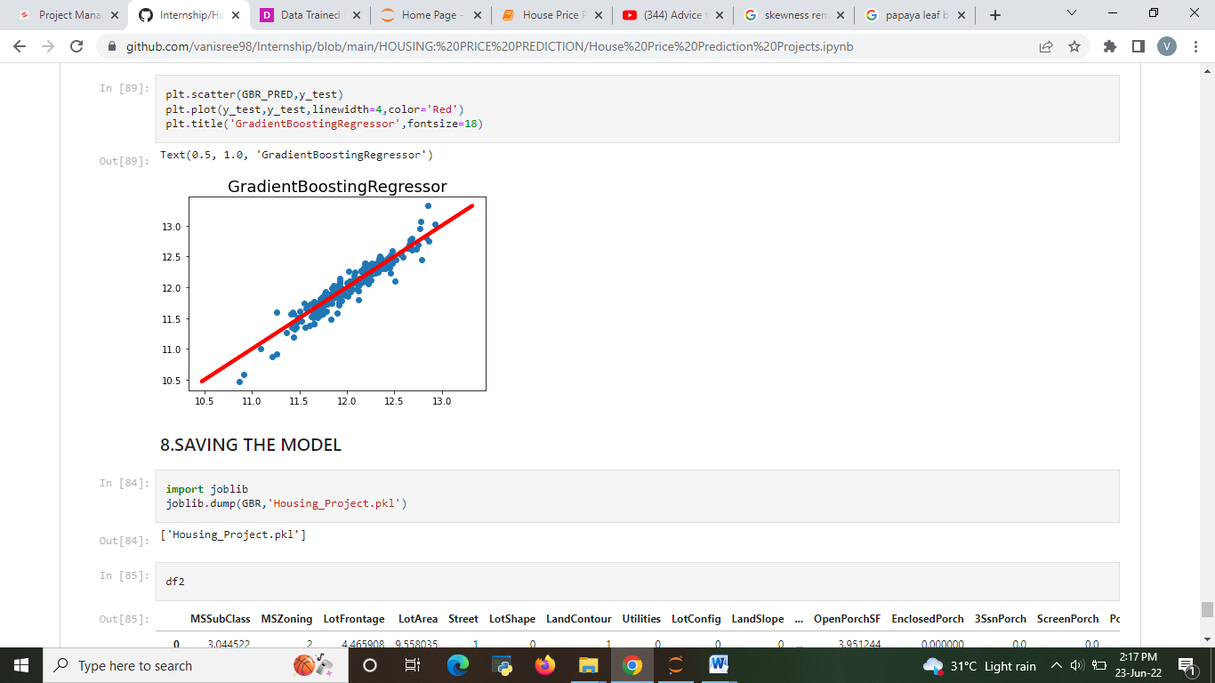

Slide 33
MAJOR FINDINGS
Totally 5 models are performed
Logistic Regression
Decision Tree Classifier
SVC
Random Forest regressor
Gradient Boosting regressor
Among that Gradient Boosting Regressor model and Random Forest Regressor
have been chosen and performed hyper parameter tuning.
Then those Gradient Boosting Regressor is evaluated using the evaluation metrics and the best model is chosen.
The best model is Gradient Boosting Regressor with
Mean Absolute Error: 0.09254705809797661
Mean Squared Error: 0.017361233604325524
Root Mean Squared Error: 0.13176203400192912
Explained Variance Score: 0.8940629407615017
r2_score: 0.8931605400835932

Slide 34
Conclusion
First uploaded the data in jupyter notebook and check the data than I visualize the features ,Perform the preprocessing in the data and understand the relationship between different features.
Correlation between the features are checked. skewness and outliers are checked . Skewness are removed by using Technique.
I used both train-validation split and the cross validation to evaluate the model effectiveness to predict the target values.5 predictive models in the data.
Then after performing Hyper parameter tuning the best model is chosen as Gradient Boosting Regressor with accuracy of 0.8931.

Slide 35
Limitations and Scope
The used pre-processing methods do help in the prediction accuracy. However, experimenting with different combinations of pre-processing methods to achieve better prediction accuracy.
Make use of the available features and if they could be combined as binning features has shown that the data got improved.
The correlation has shown the association in the local data. Thus, attempting to enhance the local data is required to make rich with features that vary and can provide a strong correlation relationship.

Slide 36
THANK YOU

